Slide 1
Setting Attributes

Slide 2
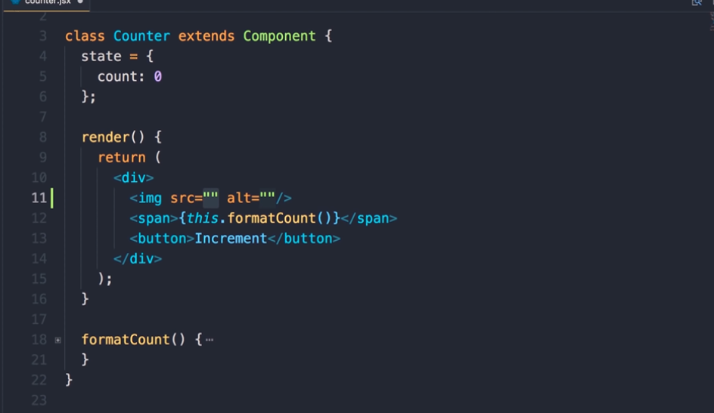

Slide 3
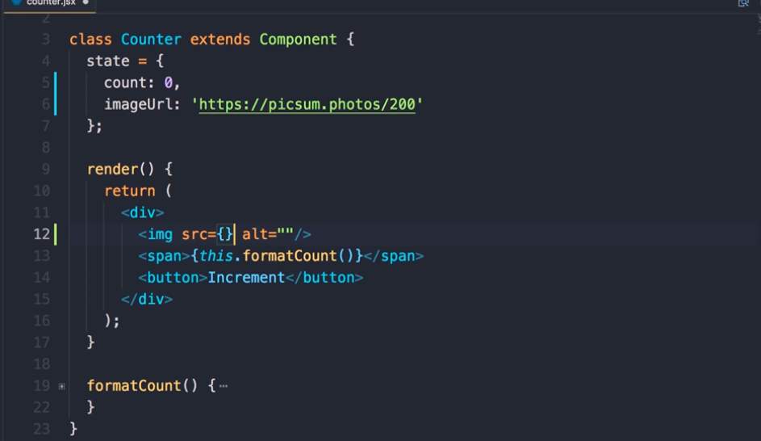

Slide 4
setting attributes
how to set attributes on these elements
for example let's add an image here we want to set the source attribute if you have couch here whatever we type in between the code is rendered as plain static text
in this demo you want to set the value of the source attribute dynamically
so let's add a property in this state object call it image URL and set it to something like this HTTP pick some photos / 200 this will generate a random 200 by 200 pixel image

Slide 5
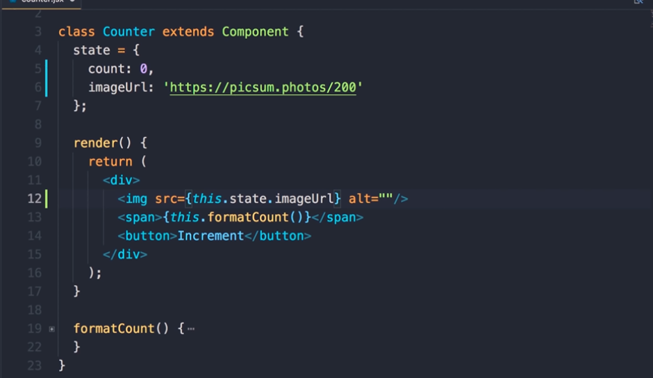

Slide 6
now back to our image element let's replace the quote with braces
and the last lecture you learned that we can use this braces to render values dynamically
See the output in the browser
so setting attribute is pretty straight forward

Slide 7
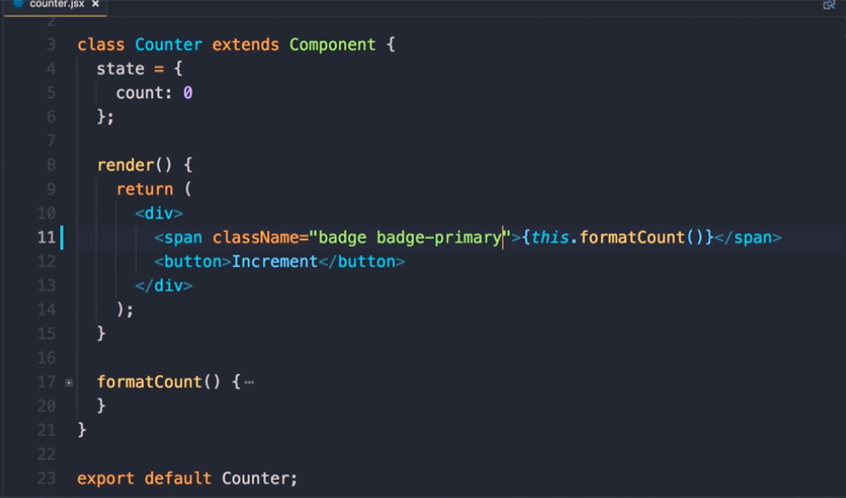

Slide 8
setting the class and style attributes because they are a little bit different
so I'm gonna delete this image element as well as the image URL
let's say we want to apply a class to this span element the name of the attribute is not class its class name because as I told you before these JSX expressions get compiled to react elements which are essentially plain JavaScript objects
we cannot use a class property on an object because that's a reserved keyword in JavaScript so the name of the attribute in JSX is classname
here I'm gonna use a couple of bootstrap classes one is badge and the other is badge – primary save the changes this is what we get a blue badge

Slide 9


Slide 10
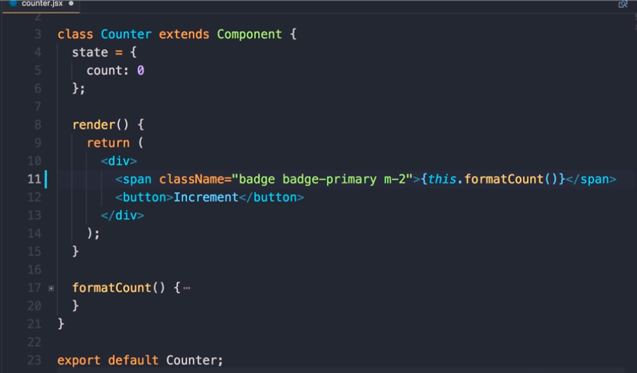

Slide 11
this badge this span is pretty close to this button we can add a bit of margin to let the UI breathe back in the code the name of the class is M - - so of margin to save the changes now you can see there's a bit of space in between the span and the button that looks better now

Slide 12


Slide 13
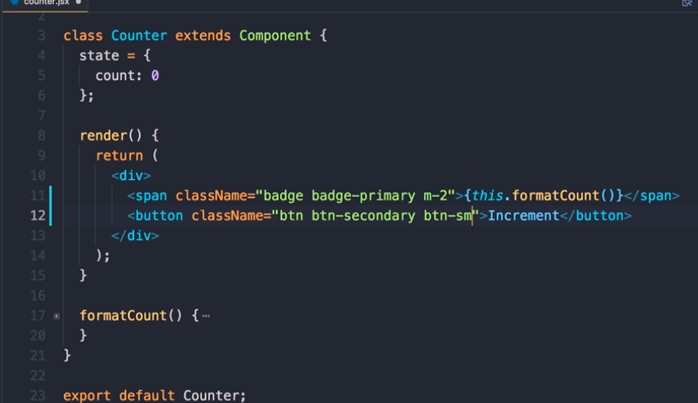

Slide 14
similarly let's apply a class to this button so back in the code here's our button class name we set this - BTN bTN - secondary add BTN - SM which is short for small now if these classes are unfamiliar to you
you need to look at bootstrap documentation
So save the changes and now our button looks different that's much better

Slide 15
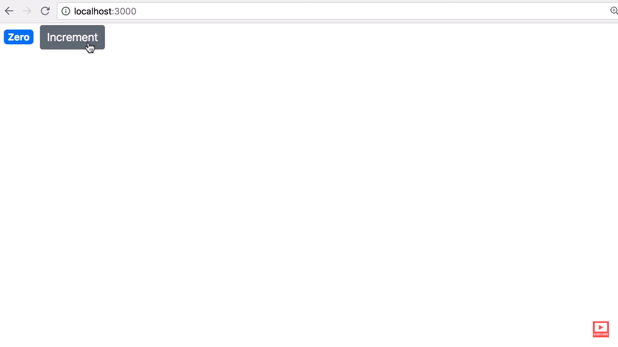

Slide 16
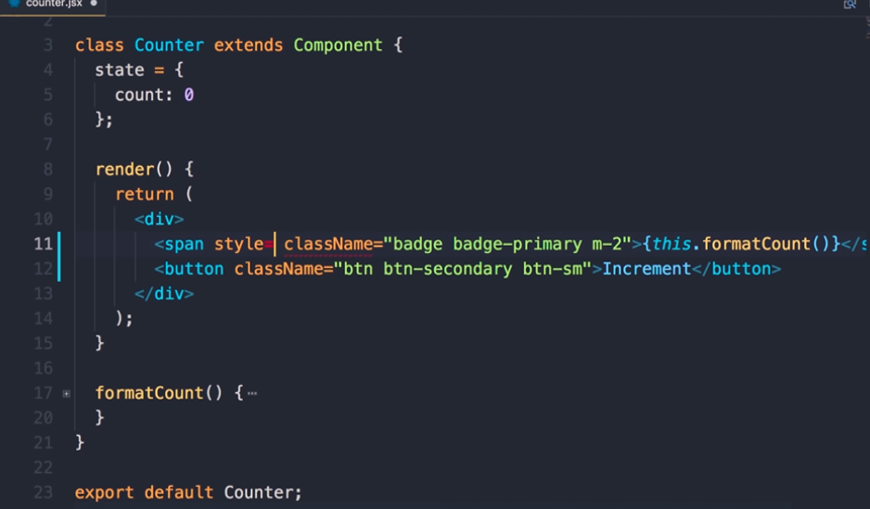

Slide 17
applying styles so for the most part it's best to use classes this is for performance and maintainability
but there are times that you may want to break the rules
if you know what you're doing and you may want to apply your style to a specific element
In JSX we have this style attribute that we need to set to a plain JavaScript object
so first we need to add curly braces here now in between these curly braces we need to pass a plain JavaScript object

Slide 18
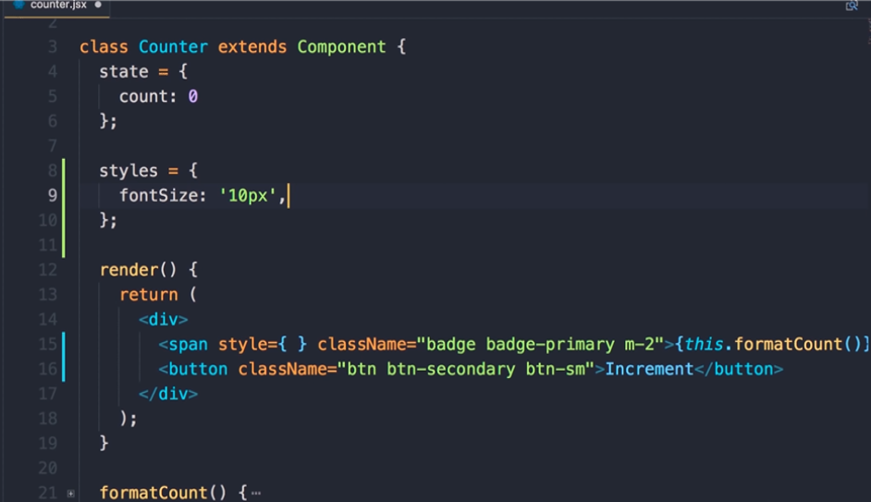

Slide 19
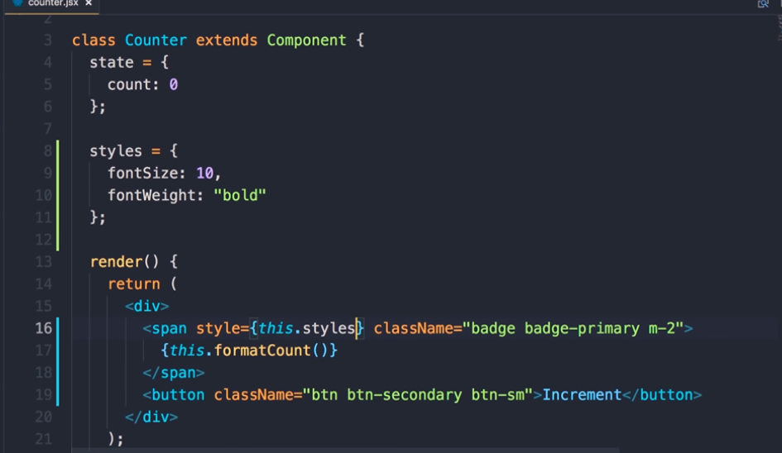

Slide 20
here's one way to do this we can define a property called it styles set it to an object
the properties of this object are CSS properties in camelcase notation
now we can set this to a numerical value like 10
react will automatically convert this to something like this so it will append pixels to yet actually this should be font size not font weight so font size 10 pixels or just a numerical 10 and we can also set font weight to bold
now we can pass this object here this.styles
save the changes now you can see our text is a little bit smaller and bold

Slide 21


Slide 22
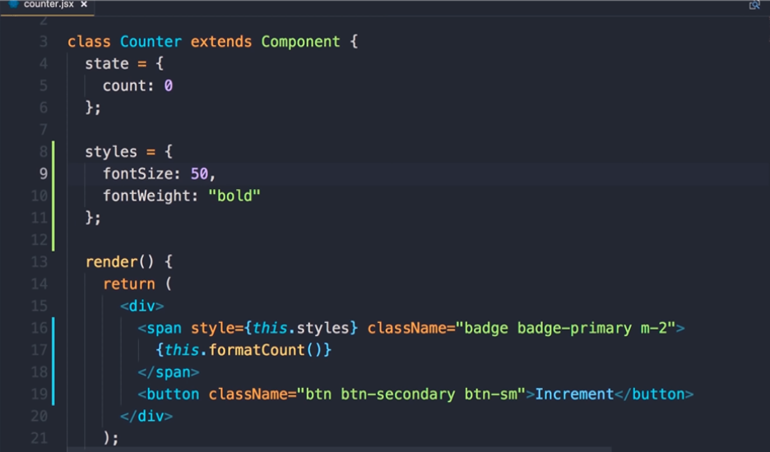

Slide 23
To demonstrate that this is actually working let me change this to let's say 50 save the changes and now we have a big badge here so this is one way to apply styles we define a property here and then reference it in our JSX expression but maybe you want to apply us to a couple of different elements so you don't want to define multiple properties in this class if that's the case you can use inline styles

Slide 24
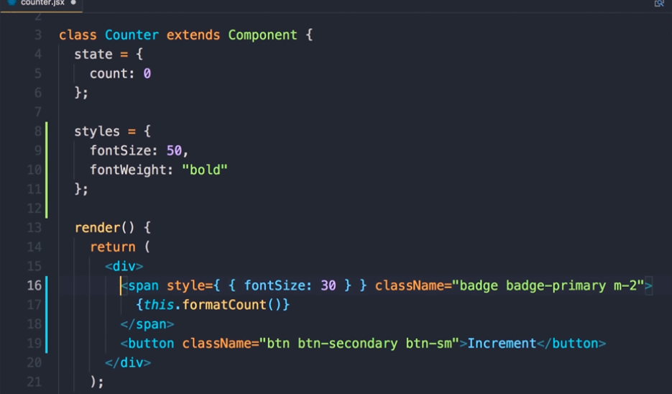

Slide 25
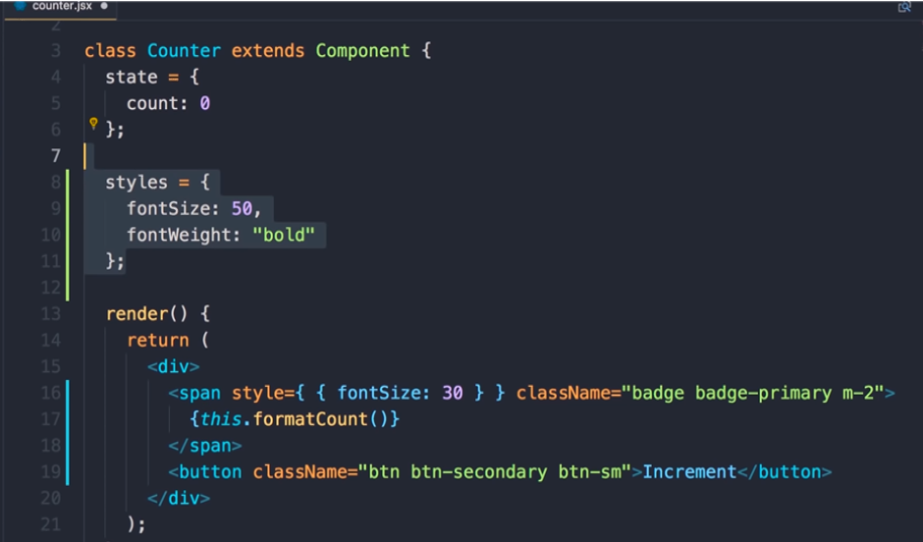

Slide 26
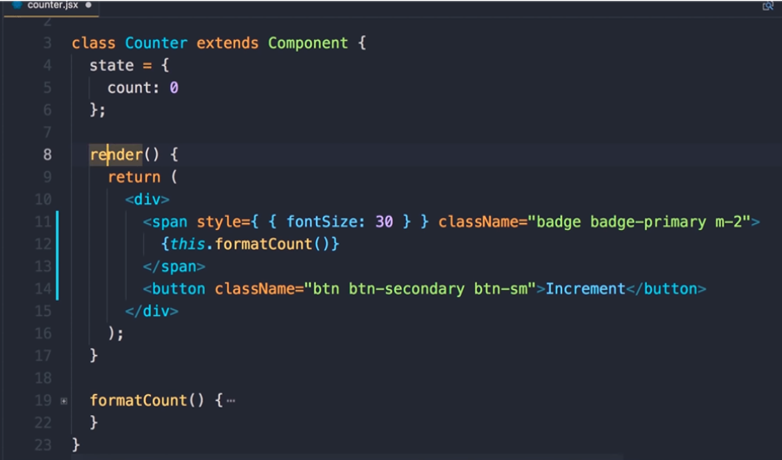

Slide 27
use inline styles so here in between this curly braces we can just pass an object and set the properties on that object so let's say font size 30 now we don't need this Styles property anymore let's save the changes with this syntax we'll get double curly braces now back in the browser you can see our badge its font size is now 30

Slide 28


Slide 29
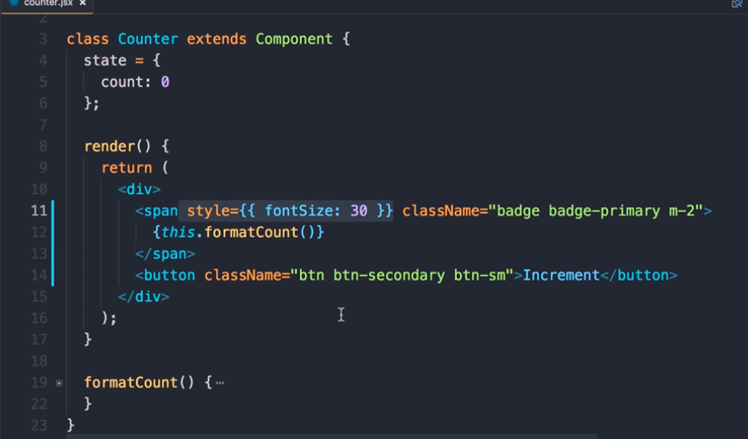

Slide 30
in this section we're only gonna use the classes so delete the style attribute

